Slide 1


Final Presentation
Pneumonia Detection Challenge
Team: Abdul, Abhishek, Ashutosh, Manish, Tanu
Mentor: Dr. Narayana

Slide 2
Problem Statement
Here’s the backstory and why solving this problem matters.
Pneumonia accounts for over 15% of all deaths of children under 5 years old internationally. In 2017, 920,000 children under the age of 5 died from the disease. In the United States, pneumonia accounts for over 500,000 visits to emergency departments and over 50,000 deaths in 2017,, keeping the ailment on the list of top 10 causes of death in the country.
While common, accurately diagnosing pneumonia is a tall order. It requires review of a chest radiograph (CXR) by highly trained specialists and confirmation through clinical history, vital signs and laboratory exams. Pneumonia usually manifests as an area or areas of increased opacity on CXR. However, the diagnosis of pneumonia on CXR is complicated because of a number of other conditions in the lungs such as fluid overload (pulmonary edema), bleeding, volume loss (atelectasis or collapse), lung cancer, or post-radiation or surgical changes. Outside of the lungs, fluid in the pleural space (pleural effusion) also appears as increased opacity on CXR. When available, comparison of CXRs of the patient taken at different time points and correlation with clinical symptoms and history are helpful in making the diagnosis.
CXRs are the most commonly performed diagnostic imaging study. A number of factors such as positioning of the patient and depth of inspiration can alter the appearance of the CXR, complicating interpretation further. In addition, clinicians are faced with reading high volumes of images every shift.

Slide 3
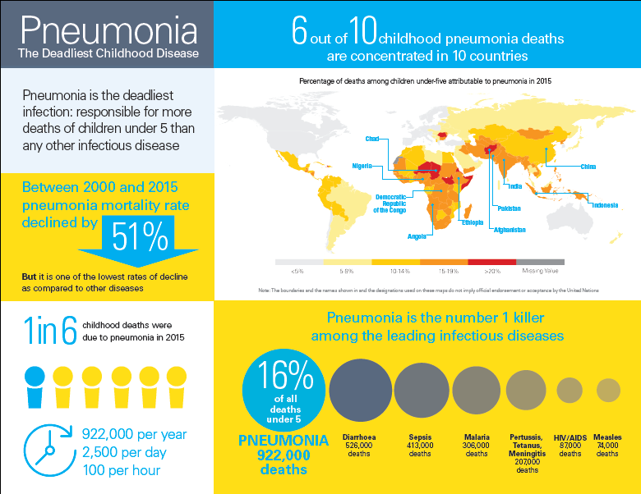
Why :
Pneumonia claims the lives of the world’s most vulnerable children
Pneumonia remains the leading infectious cause of death among children under five, killing approximately 2,400 children a day.
There was an estimated 880,000 deaths from pneumonia in children under the age of five in 2016. Most of its victims were less than 2 years old.
Pneumonia is a huge burden on our healthcare systems.
In the US, pneumonia was one of the top ten most expensive conditions seen during inpatient hospitalizations. In 2013, pneumonia had an aggregate cost of nearly $9.5 billion for 960,000 hospital stays.

Slide 4
Business Domain Value
Automating Pneumonia screening in chest radiographs
Assist physicians to make better clinical decisions or even replace human judgement in certain functional areas of healthcare (eg, radiology).
Guided by relevant clinical questions, powerful AI techniques can unlock clinically relevant information hidden in the massive amount of data, which in turn can assist clinical decision making.

Slide 5
Past Research
A Team from National Institutes of Health & The Ohio State Univ. Wexner Medical Ctr. ( USA ) did a research on:
Abstract: “Visualizing and explaining deep learning predictions for pneumonia detection in pediatric chest radiographs”
Findings: The disease is reported to affect approximately 450 million people across the world, resulting in 2 million pediatric deaths every year. Chest X-ray (CXR) analysis is the most frequently performed radiographic examination for diagnosing the disease. Unlike pneumonia in adults, pediatric pneumonia is poorly studied. Computer-aided diagnostic (CADx) tools aim to improve disease diagnosis and supplement decision making while simultaneously bridging the gap in effective radiological interpretations during mobile field screening. These tools make use of handcrafted and/or convolutional neural networks (CNN) extracted image features for visual recognition.
Conclusion: CNNs are perceived as black boxes since their performance lack explanations and poorly understood. The lack of transparency in the learned behavior of CNNs is a serious bottleneck in medical screening/diagnosis since poorly interpreted model behavior could unfavorably impact decision-making.

Slide 6
Dataset used
We are using the dataset provided by RSNA on Kaggle with the below features:
stage_2_train.csv - the training set. Contains patientIds and bounding box / target information.
stage_2_detailed_class_info.csv - provides detailed information about the type of positive or negative class for each image.
patientId _- A patientId. Each patientId corresponds to a unique image.
x_ - the upper-left x coordinate of the bounding box.
y_ - the upper-left y coordinate of the bounding box.
width_ - the width of the bounding box.
height_ - the height of the bounding box.
Target_ - the binary Target, indicating whether this sample has evidence of pneumonia.
stage_2_train_images - set of training images
stage_2_test_images - set of test images
Dicom original images:- Medical images are stored in a special format called as DICOM files (*.dcm). They contain a combination of header metadata as well as underlying raw image arrays for pixel data

Slide 7
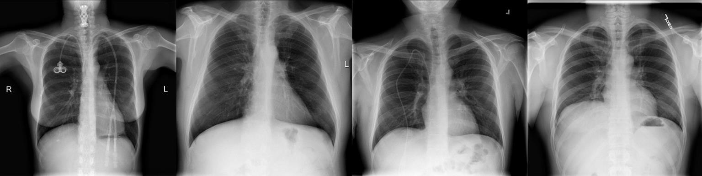
Exploratory Visualization (Contd.)
Tissues with sparse material, such as lungs which are full of air, do not absorb the X-rays and appear black in the image. Dense tissues such as bones absorb the X-rays and appear white in the image.

Slide 8
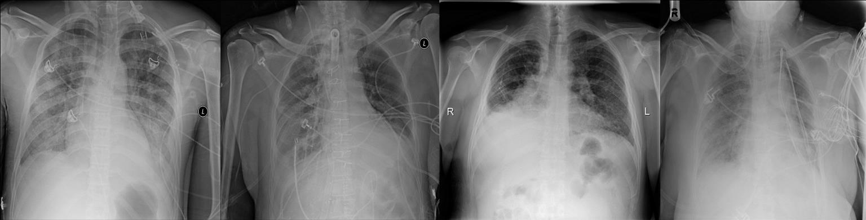
Exploratory Visualization (Contd.)
When a person has pneumonia, however, air is replaced by fluid, bacteria, immune system cells, and other objects. For such an X-Ray, the opacities tend to have a greyish color, and a cloudy appearance,
rather than being black or white. You can see some images with pneumonia related opacities below.

Slide 9
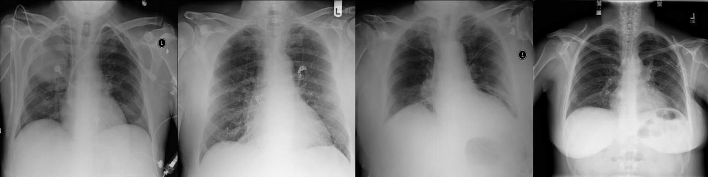
Exploratory Visualization
While we are theoretically detecting “lung opacities”, there are lung opacities that are not pneumonia related.
In the data, some of these are labeled “Not Normal No Lung Opacity”. This extra third class indicates that while pneumonia was determined not to be present, there was nonetheless some type of abnormality on the image and oftentimes this finding may mimic the appearance of true pneumonia. These non pneumonia “Not Normal” detections end up being a primary source of frustration in building models
The images below show a few of the examples in the “Not Normal” class.

Slide 10
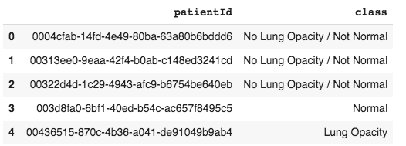
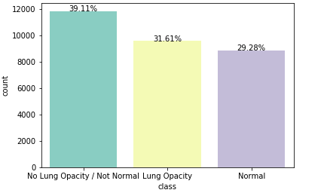
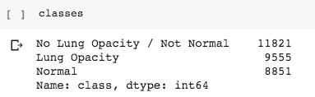
Exploratory Data Analysis
Preliminary EDA insights - class_info dataset
•30227 rows and 2 columns
-patientId and class
•Missing values –nil
•26684 unique patients
•Class distribution

Slide 11
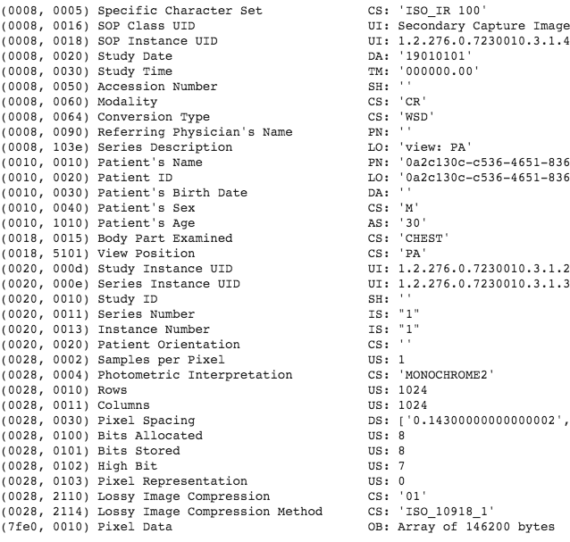
Preliminary EDA insights –training images
Training has 26684 unique images
•Images are dcm format
•Every image has the following details
-Patient sex;
-Patient age;
-Modality;
-Body part examined;
-View position;
-Rows & Columns;
-Pixel Spacing.

Slide 12
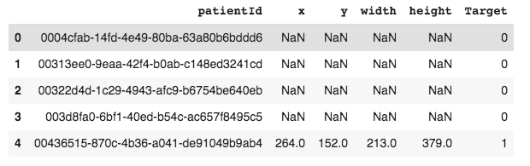
Preliminary EDA insights -train labels dataset
•30227 rows and 6 columns
-patientId and x, y coordinates, width, height of the bounding boxes and target indicating Pneumonic case or not
•Missing values –nil
•26684 unique patients

Slide 13
Model building
Initially we tried building a CNN from scratch
With a kernel with MASK-RCNN library
YOLO V3 and darknet
YOLO V2 with darkflow
YOLO V2 with darkflow for Tensorflow (TFNet)
This is our final model

Slide 14
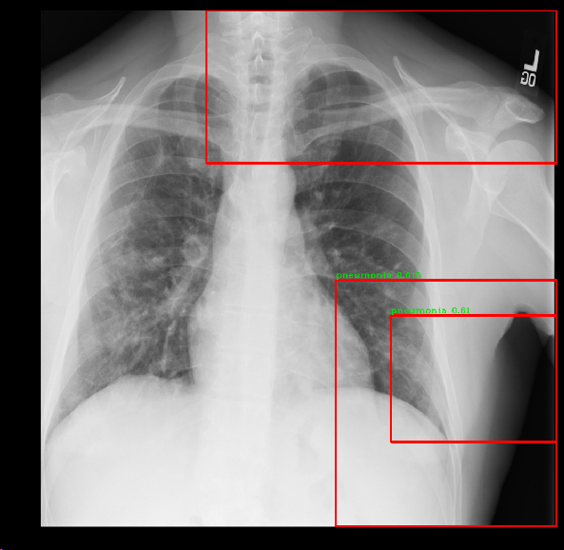
YOLO V2 with TFNet – v1
Set up in colab
Trained on 5 images
Accuracy is very low, poor prediction of bounding boxes

Slide 15
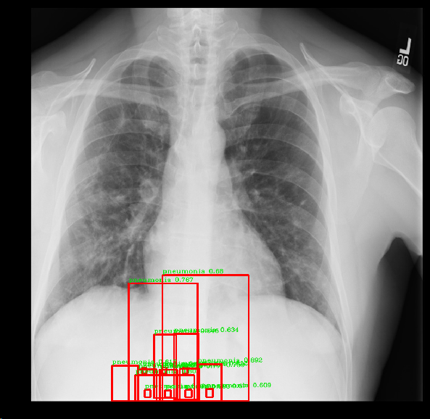
Yolo V2- TFNet – V2
Trained the model on 230 images
Getting lower prediction of bounding boxes

Slide 16
Yolo V2- TFNet – V3
We are working on training 1000 images
We will be using at least 100 epochs

Slide 17
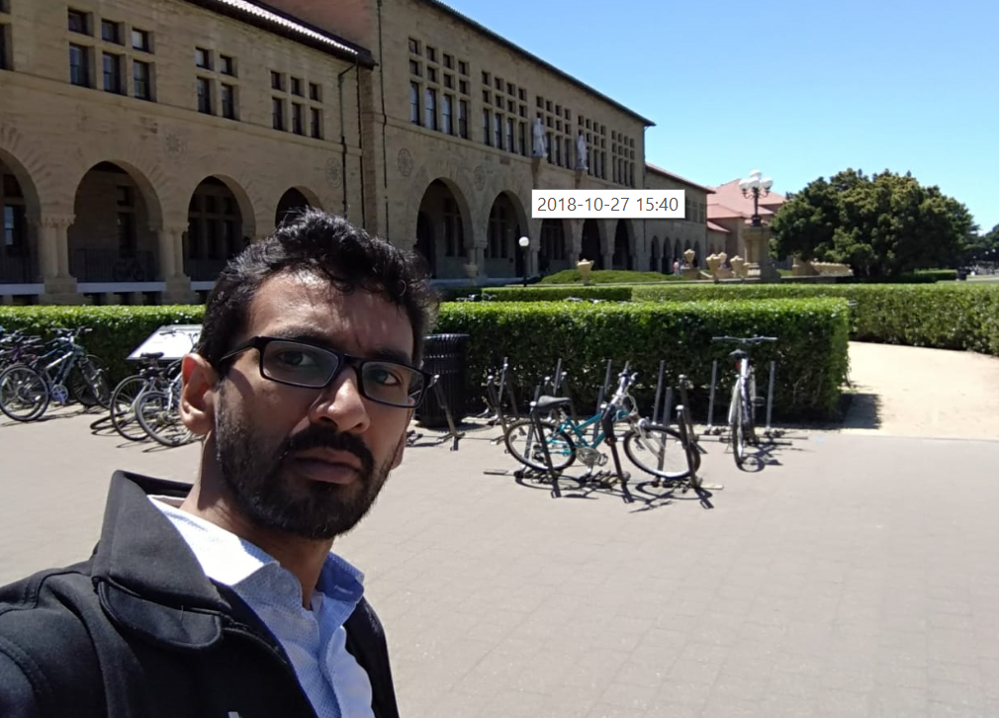
ChexNet
Not much documentation available
Got a chance to meet with Hershel Mehta
Working with him
Pre trained weights are not available

Slide 18
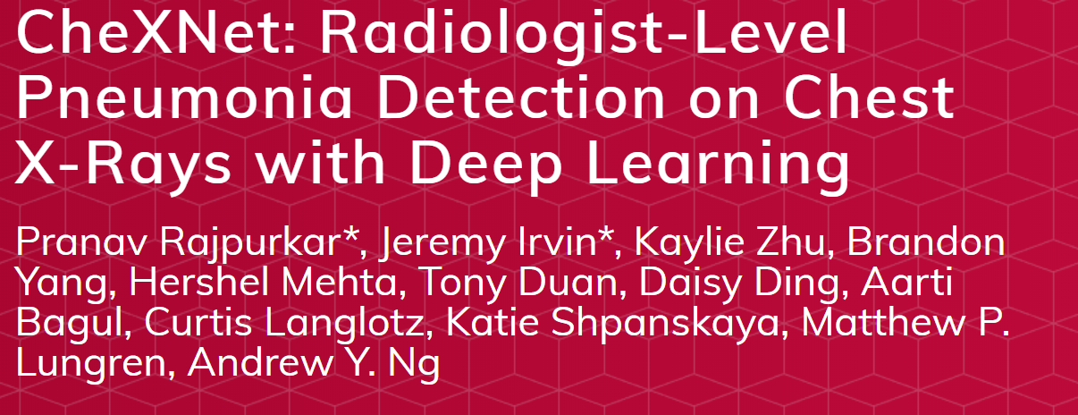

ChexNet – Interaction with Hershal Mehta

Slide 19
Suggestions from Hershal Mehta
Yolo may not help us with accuracy
Train a CNN using transfer learning for classification and see the insights – follow DenseNet 121 architecture
Try Yolo with
Larger image set (5000+ images) to increase accuracy
Aim for 100 epochs of run

Slide 20
Code
V1
V2

Slide 21
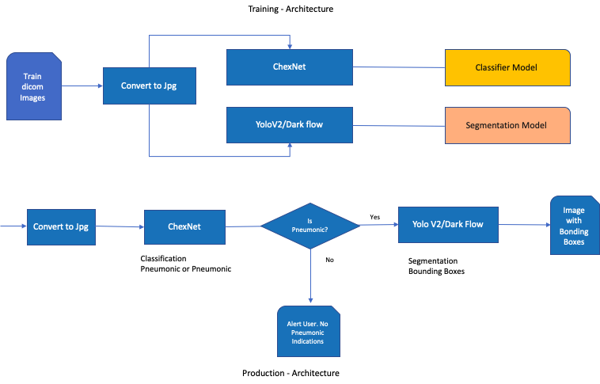
Architecture

Slide 22
Model evaluation
●The evaluation metrics is based on the mean average precision at different intersection over union (IoU) thresholds. The IoU of a set of predicted bounding boxes and ground truth bounding boxes is calculated as:
IoU(A,B)=A∩BA∪B.IoU(A,B)=A∩BA∪B.
●The metric sweeps over a range of IoU thresholds, at each point calculating an average precision value. The threshold values range from 0.4 to 0.75 with a step size of 0.05:(0.4, 0.45, 0.5, 0.55, 0.6, 0.65, 0.7, 0.75). In other words, at a threshold of0.5, a predicted object is considered a "hit" if its intersection over union with a ground truth object is greater than 0.5.
●At each threshold value, a precision value is calculated based on the number of true positives (TP), false negatives (FN), and false positives (FP) resulting from comparing the predicted object to all ground truth objects:
TP(t)TP(t)+FP(t)+FN(t).TP(t)TP(t)+FP(t)+FN(t).
●A true positive is counted when a single predicted object matches a ground truth object with an IoU above the threshold. A false positive indicates a predicted object had no associated ground truth object. A false negative indicates a ground truth object had no associated predicted object.

Slide 23
Model evaluation(contd..)
●Important note:if there are no ground truth objects at all for a given image, ANY number of predictions (false positives) will result in the image receiving a score of zero, and being included in the mean average precision.
The average precision of a single image is calculated as the mean of the above precision values at each IoUthreshold:
1|thresholds|∑tTP(t)TP(t)+FP(t)+FN(t).1|thresholds|∑tTP(t)TP(t)+FP(t)+FN(t).
●Bounding boxes will be evaluated in order of their confidence levels in the above process. This means that bounding boxes with higher confidence will be checked first for matches against solutions, which determines what boxes are considered true and false positives.
Intersection over Union (IoU)
●Intersection over Union is a measure of the magnitude of overlap between two bounding boxes (or, in the more general case, two objects). It calculates the size of the overlap between two objects, divided by the total area of the two objects combined.
●The two boxes in the visualization overlap, but the area of the overlap is insubstantial compared with the area taken up by bothobjects together. IoUwould be low -and would likely not count as a "hit" at higher IoUthresholds.

Slide 24
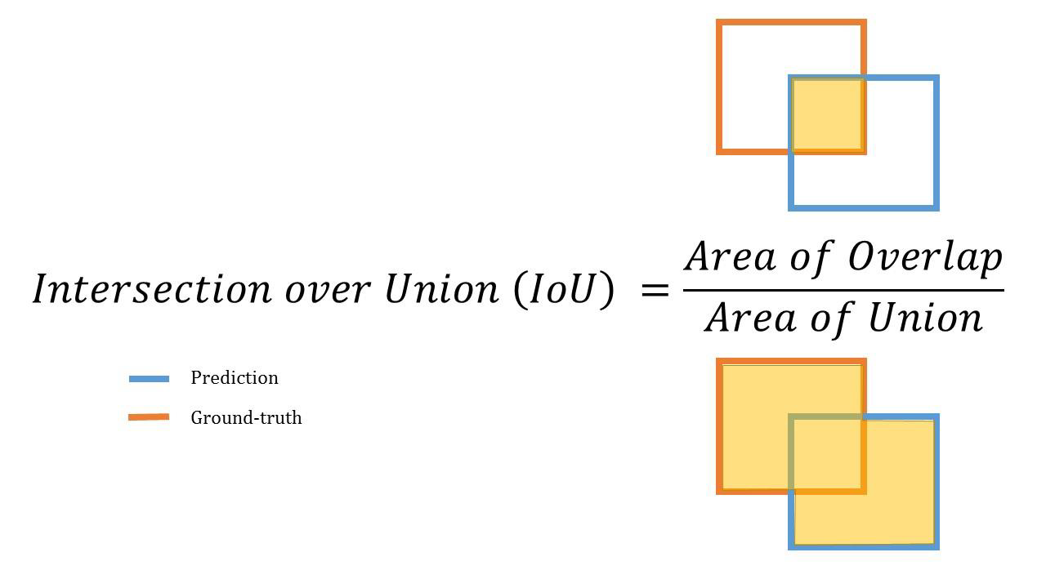
Model evaluation(contd..)

Slide 25
Challenges, learning, achievements
Infrastructure
Domain knowledge
Identifying right model
Virtual Collaboration
Networking

